Slide 1
BrainReach Elementary
Orientation 2015

Slide 2
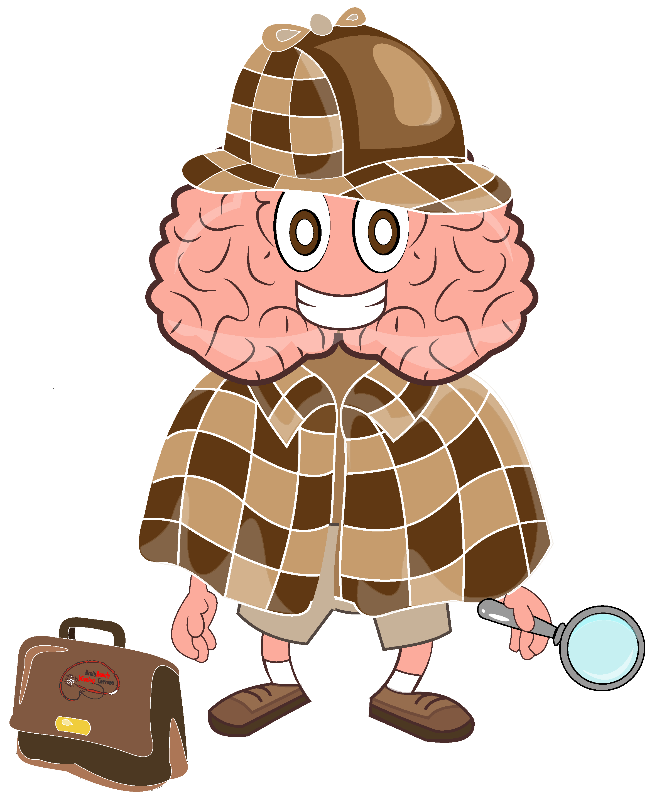
Outline
The Goals of BrainReach
Administrative Information
Teaching Strategies

Slide 3
The Goals of BrainReach Elementary
Provide scientific engagement for elementary school students in under-resourced neighbourhoods, showing them that science is fun through interactive presentations and activities focusing on the brain.
Provide teachers with a support network for their science inquiries.
Provide graduate students with the opportunity to build pedagogical skills.
Notes:
As BrainReach Educators, you’ll be teaching neuroscience-based interactive workshops in grade 4 classes. In most cases, 8 workshops will be given in the same classes on a monthly basis. A few schools have requested slightly different schedules, and this was indicated in your matching email if applicable.
BrainReach elementary has 3 main goals. The first is to provide scientific engagement to grade 4 students in schools that might not otherwise have the resources to offer science activities, such as field trips or equipment for experiments, that show students that science can be fun. We aim to show the students that science is interesting and fun, relevant to their daily life, and that anyone can do it. Neuroscience is a great topic through which to do this since its tangible and relevant to everything that the students do. Its important to remember this objective during your presentations- learning the facts is important, but the main goal is to show them that science is fun and interesting. Remembering how fun and interesting that brain class was will stick with them for a long time, remembering the exact name of every brain cell probably won’t.
The second goal is to provide teachers with a support network for their science inquiries. This network consists of you, the BrainReach Educators, as well as the BrainReach committees. The committees prepare 2 teachers packages each year and email them to the teachers. These packages contain additional information, such as common questions or myths, about the presentation topics and neuroscience in general, as well as ideas for activities they can implement in their classes. The committees are also available to answer questions throughout the year. If your teachers (or students!) have questions about the presentation topics, neuroscience in general, or how they can further neuroscience education in their classes, try your best to answer them. If you’re not sure how to answer it, make sure to look for the answer or contact the brainreach committee, and get back to them.
The third goal is to provide the BrainReach Educators with the opportunity to build teaching skills. Teaching is an extremely important skill for both academic and non-academic careers, and teaching children is especially useful since a variety of teaching methods are applied and it provides the opportunity to develop skills in preparing and delivering clear explanations.

Slide 4
Presentation Topics
What is the brain?
What are the different functions of my brain?
What is my brain made of?
How does my brain get information from the world?
How does my brain pay attention?
How do I remember?
How does my brain control my emotions?
Presenter’s choice of topic, or review

Slide 5
Your Role as a Volunteer
Communicate with your assigned school to schedule presentations
Arrange material pickup/return
Prepare for your presentations
Deliver the presentations in an engaging and professional manner
Help us make BrainReach even better by providing feedback
Communicate with the BrainReach Elementary committee about any ideas, suggestions or issues

Slide 6
Scheduling Presentations
Schedule presentations
Arrange material pickup/return
Prepare for your presentations
Deliver the presentations
Provide feedback
You will be assigned a school by email
In the next few days, we’ll send an email to both you and your teacher
After your receive this, get in touch with them as soon as possible to schedule your first session
  Confirm the class day, time and length
  Ask how many students are in the class, and if there are any special needs
  Confirm the procedure for when you arrive at the school
At your first session, arrange a schedule with your teacher for the remaining sessions

Slide 7
Scheduling Presentations
Schedule presentations
Arrange material pickup/return
Prepare for your presentations
Deliver the presentations
Provide feedback
Presentations should be held monthly unless otherwise indicated, starting as soon as you can
If you have a busy month in your schedule and can’t make it LET US KNOW. We have volunteers who registered as backups.
If you can no longer teach LET US KNOW. We will try to find a replacement, rather than leave the school hanging.
The most important people to please in BrainReach are the students we teach. We are committed to providing the students with all the presentations. They look forward to our visits!
Notes:
It is very important that you follow through with your commitment to be a BrainReach Educator and teach all 8 sessions in your classes. However, we understand that unexpected situations come up.

Slide 8
Material Pickup/ Return
Schedule presentations
Arrange material pickup/return
Prepare for your presentations
Deliver the presentations
Provide feedback
All presentations have materials and/or handouts that will be provided for you
Email brainreach.elementary@gmail.com at least one week before your scheduled presentation to request materials
In the email, please include:
  Presentation date
  Session number
  The total number of students you will be teaching (i.e. 2 classes of 25 students = 50 students)
  English or French

Slide 9
Material Pickup/ Return
Schedule presentations
Arrange material pickup/return
Prepare for your presentations
Deliver the presentations
Provide feedback
A committee member will let you know when your materials will be ready to pick up
Materials can be picked up and returned in the IPN office (room 141, MNI) between 8:30am and 5:30pm. Pickup can be arranged after hours if necessary.
Please fill out the sign-out sheet
We only have enough material for a small number of classes. Please return all materials and leftover handouts within 24h of your presentation.
Notes:
Material packages vary by session, but can include the following items: summary handouts to be given at the end of each session, printed materials (ex. matching cards) for activities, or other materials for activities, such as brain models or a microscope.
It is much preferred to pick up material while the office is open, but in special circumstances, we can arrange after-hours pickup if advance notice is given.
Material will be ready at least one day before the presentation.

Slide 10
Prepare for Your Presentation
Schedule presentations
Arrange material pickup/return
Prepare for your presentations
Deliver the presentations
Provide feedback
All presentations have been prepared for you
However, the presentations are just a skeleton to guide you. You can add to or remove information from your presentation. In fact, we stress that you should customize your presentation!
Build it according to the needs and wants of your class, and the length of the class

Slide 11
Prepare for Your Presentation
Schedule presentations
Arrange material pickup/return
Prepare for your presentations
Deliver the presentations
Provide feedback
BrainReach Wiki: brainreach.wikispaces.com
There is a wiki page for each session which contains:
  Presentation slides
  Presenter’s guide
  Sample of handouts/materials (will be printed for you)
Notes:
Make sure to go to the wiki at this address and register for access as soon as possible!

Slide 12
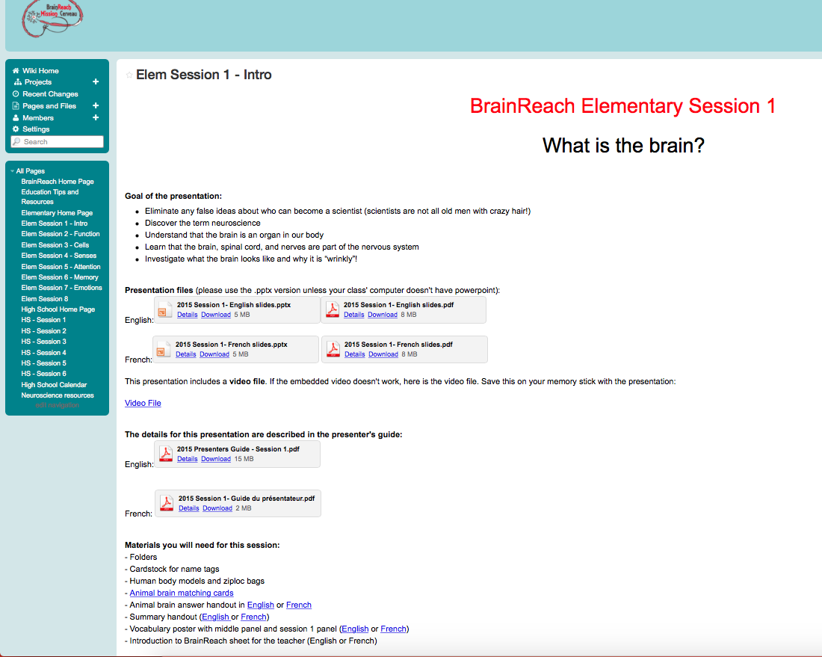
Prepare for Your Presentation
Schedule presentations
Arrange material pickup/return
Prepare for your presentations
Deliver the presentations
Provide feedback
BrainReach Wiki: brainreach.wikispaces.com

Slide 13
Prepare for Your Presentation
Schedule presentations
Arrange material pickup/return
Prepare for your presentations
Deliver the presentations
Provide feedback
Presenter’s guide:
Slide by slide description of the presentation
  Tips on how to present the material
  Helpful websites
Gives you a guide for approximate time you should spend on a slide
Explains the activities for the session
DO NOT READ FROM THE GUIDE DURING YOUR PRESENTATION!
Important Note: This is meant as a foundation….you can tweak it…in fact we insist you do!

Slide 14
Delivering Presentations
Schedule presentations
Arrange material pickup/return
Prepare for your presentations
Deliver the presentations
Provide feedback
The teacher should be present, but you are leading the class during the presentation
Presentation tips and helpful information for the upcoming sessions will be shared through email and our Facebook page
Presentation tips can also be found on the Wiki
We are not just giving presentations….we are teaching and inspiring students!!
Do not check your phone while in the classroom!

Slide 15
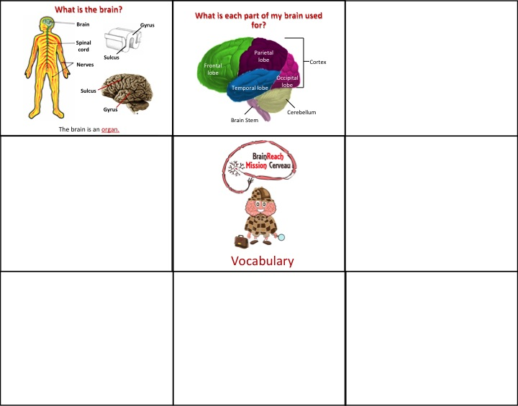
Delivering Presentations
Schedule presentations
Arrange material pickup/return
Prepare for your presentations
Deliver the presentations
Provide feedback
Question folder
Vocabulary poster

Slide 16
Delivering Presentations
Schedule presentations
Arrange material pickup/return
Prepare for your presentations
Deliver the presentations
Provide feedback
NEW THIS YEAR: Brain Boost
A game at the beginning of sessions 2-7 to review what the students learned in the previous session

Slide 17

Brain Boost!
Neuroscience
Groovy Brain 1
Groovy Brain 2
Notes:
Slide 2 (slides 2-8 should take ~ 5 minutes):
It’s very important to review with the students what they have already learned. Start the class with the “Brain Boost” game.
Take 2 minutes to explain the game: This is an activity to help them review what they learned from the previous session. The game consists of 3 questions based on the material from the previous session. Students will choose a category (without knowing the question) and will then answer a question from that category. To make it more challenging, you can time the class to see how fast they can complete the Brain Boost and see if they can break their record in the following session! (The rest of the sessions will also start with a Brain Boost) Follow these steps to lead the activity:
1. Choose a student who would like to participate. You can ask everyone who wants to participate to raise their hands, and choose the student who raised their hand first. Alternatively, you could write down a number between 1 and 10 (secretly so no one else sees), ask the students to call out what they think the number is, and choose the first one you hear with the correct number. Feel free to use any other method that you would like, as long as it is fair and only students who want to participate are chosen.
Only one student can choose and answer a question at a time.
2. Ask the chosen student to choose a category from the 3 listed on this slide. Click that link (category name) on this slide to go to the slide with that category’s question. The categories can be chosen in any order.
3. Read the question aloud and give the student a few seconds to answer. The student answering can ask a classmate for help if they do not know the answer.
If they get it wrong, tell them that it was a good try but wasn’t the answer you were looking for, and choose another student (using the same method you used in step 1) to answer the same question.
Its best to have the students answer the questions without looking at the poster or summary sheet, but if they are struggling with a question, you can hint to them that they might be able to find the answer there.
4. Once the correct answer was given, click the question to go to the answer slide and briefly review that concept.
Repeat these steps for the remaining two questions, choosing different students each time. Each question/answer should take approximately one minute.

Slide 18
Neuroscience
What are neuroscientists?
Notes:
Slide 3: Click the question to go to the answer page.

Slide 19
Groovy Brain 1
Why do brains have folds?
Notes:
Slide 4: Click the question to go to the answer page.

Slide 20
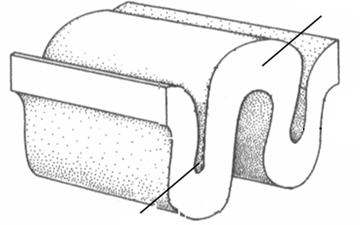
Groovy Brain 2
What are the bumps and grooves of the brain called?
Notes:
Slide 5: Click the question to go to the answer page.

Slide 21
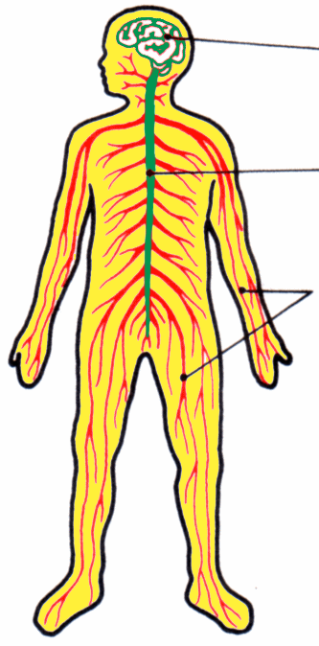
Brain
Spinal cord
Neuroscientists are scientists who study the brain and the nervous system!
Nerves
Brain Boost Home
Finish Brain Boost
Notes:
Slide 6:
Recall from last class that neuroscientists are scientists who study the brain and the nervous system.
The brain is an organ and is part of the nervous system. It is the control center for our bodies and all animals have a brain.
Click the blue star to return to the Brain Boost Home page or the red star finish the Brain Boost and to continue with the presentation.

Slide 22

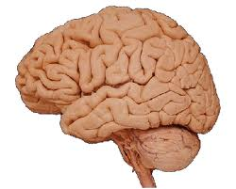
Folds in the brain allow for a larger surface area to store more information!
Brain Boost Home
Finish Brain Boost
Notes:
Slide 7:
Folds in the brain allow for a larger surface area to store more information. Ask the students to recall the activity where they had to put a piece of paper in their pocket. They had to crumple or fold the piece of paper in order to fit it in the pocket. The brain is grooved for the same reason; to be able to fit so much information in a limited space or container (the skull).
Click the blue star to return to the Brain Boost Home page or the red star finish the Brain Boost and to continue with the presentation.

Slide 23
gyrus
sulcus
Brain Boost Home
Finish Brain Boost
Notes:
Slide 8:
A bump is called a “gyrus” and a groove is called a “sulcus”.
Click the blue star to return to the Brain Boost Home page or the red star finish the Brain Boost and to continue with the presentation.

Slide 24
Providing Feedback
Schedule presentations
Arrange material pickup/return
Prepare for your presentations
Deliver the presentations
Provide feedback
Receiving feedback from volunteers and teachers helps us to improve presentations and the program in general
You will receive a feedback form with your material package for each session
Please complete it and return it along with your materials

Slide 25
Providing Feedback
Schedule presentations
Arrange material pickup/return
Prepare for your presentations
Deliver the presentations
Provide feedback

Slide 26
Communicating with the BrainReach Elementary Committee
Feel free to email us at brainreach.elementary@gmail.com if you:
  have any ideas or suggestions for how we can make the presentations or program even better
  are having trouble contacting your teacher
  encountered any situations or questions from students or teachers and are not sure how to handle them
  have any questions about the presentations or the program in general

Slide 27
Communicating with the BrainReach Elementary Committee
The committee will communicate with you through:
  timely responses to your emails at any time during the year
  emails throughout the year
  our Facebook page, where we’ll share useful and interesting resources on neuroscience topics and teaching tips

Slide 28
Enjoy your experience with BrainReach!
Questions?

