Slide 1
Hello, my name is…
Notes:
Please refer to “The Volunteer General Guide” for tips on how to make this virtual experience more engaging.
Before your first session: Make sure you have contacted the teacher at the school you will be volunteering at. You want to know how long the class is, how many students are in the class, whether there are any special needs students and whether the teacher has any special requests. Tell the teacher about the “Draw a scientist activity” which is to be completed before you teach the first session. This task simply requires that the teacher asks his/her students to draw a scientist (without giving them any aids), so that we can see how the students perceive scientists. In light of the COVID-19 pandemic, please ask the teacher whether they might like to conduct the draw a scientist activity during the class for a maximum of 3 minutes for all the students.
Goal of this presentation:
Eliminate any false ideas about who can become a scientist (scientists are not all old men with crazy hair!)
IMPORTANTLY, please note to your students in this presentation that scientists can look like anyone; in fact, science is a highly inclusive environment
Discover the term neuroscience
Understand that the brain is an organ in our body
Learn that the brain, spinal cord, and nerves are part of the nervous system
Investigate what the brain looks like and why it is “wrinkly”!
Materials the teacher may need for this presentation (if they agree to print):
Folders
Animal brain matching cards
Summary handout
Vocabulary poster, middle panel & session 1 panel
Some general websites you might find helpful:
https://www.healthline.com/health/fun-facts-about-the-brain
http://faculty.washington.edu/chudler/neurok.html
http://www.findingdulcinea.com/guides/Science/Science-of-the-Brain.pg_03.html
https://dana.org/category/brain-basics/qa-about-the-brain/
Slide 1 - (~5 min):
Start by introducing yourself to the class. Tell them you are a scientist. Explain to them that you will be visiting their classes once a month as part of the BrainReach program, in which they are going to learn all about the brain!
For those classes without a webcam, we can still present ourselves to the class by having the teachers ask the students to come up, one at a time, to the microphone and to ask a question and present themselves.
Also distribute a folder to each student and have them write their name on it (this is optional – if the teacher agrees, they will do this part). This folder is for them to store their handouts that they will get each session (only if the teacher agrees to print these handouts).
There can also be a questions folder if the teacher agrees; students can place any questions that they have after the session into this folder (the teacher will then share these questions with you). The maintenance of the folder will ensure that students feel comfortable connecting with the volunteers. — please READ QUESTIONS DURING THE NEXT CLASS.
Please be sure to also go through summary slides together as a class (especially if the teacher will not be printing summary sheets).
Vocabulary Poster: We have prepared a vocabulary poster for you to hang in the classroom during the first class (that will remain in use throughout the year). This poster is split into 9 boxes- a middle panel and one for each session. Each session you will bring a new panel to add to the poster with the vocabulary from that day. In light of the COVID-19 pandemic, keep in mind that this is optional – you need to ask the teacher if they are willing to print this and hang it up in their class. If not, you may just review these terms every session if you like.

Slide 2
Draw a Scientist!
Notes:
Slide 2 - (~5 min):
Have the students take out a piece of paper and some pencils/markers to draw. Ask the students to draw a scientist (without giving them any aids), so that we can see how the students perceive scientists. Ask the students to do this in class with you and ask them “what do you think a scientist looks like?”
Please refer to “The Volunteer General Guide” for tips on virtual activities.

Slide 3
What is SCIENCE?
What is NEUROSCIENCE?
Notes:
Slide 3 - (3 min):
Remind the students you are a scientist, and that anyone can become a scientist. Brainstorm with the students: what they think scientists do? Explain to the students that neuroscientists are scientists that study the brain, and share with the students what you study. Tell them that during the entire year they will be BrainReach Investigators and they will be learning neuroscience with you!
Creative commons attribution license

Slide 4
What do we study?
Your Picture
Your Research
Notes:
Slide 4 - (~2 min):
This is a customizable slide that you can use to explain what particular parts of neuroscience research you are involved in. We recommend using the template above as a guide, and include a photo of yourself (preferable doing something related to your research), as well as a photo related to your particular field of research. Of course, this template is just a suggestion, feel free to present your research in whatever way you like!
However, do take care to not describe your research using complex or technical terms. Giving the goals of your research or methods that you use is usually enough (ex. “I study the brains of people with cancer).
Be sure to talk to the students about what part of your research makes you most excited/fascinated!

Slide 5
Session 1: What is the brain?
What do you know about
the brain?
Notes:
Slide 5 - (~5 min):
Today is session 1 of BrainReach and the central theme is: What is the brain?
Ask the students what they already know about the brain or what they may have heard or seen in movies and on TV.
Please refer to “The Volunteer General Guide” for how to make these types of question interactive for your classroom setting.
Use this time to get a feeling for what the students already know and what they are interested in (i.e. are there many questions on dreams, memory etc). This will be useful in preparing for future sessions. If they mention info that is false (i.e. we use 10% of our brain – we use virtually every part of the brain and most of the brain is active almost all of the time), you should use this chance to go into more details and clarify any misconceptions.
If your students are quiet and not volunteering, try having every student mention one thing they heard before about the brain. Alternatively you can ask some prompting questions:
Ex. How big is the brain? What is the brain used for? What does the brain look like?
Helpful websites: Check out this website for some fun facts about the brain.
http://www.nursingassistantcentral.com/blog/2008/100-fascinating-facts-you-never-knew-about-the-human-brain/

Slide 6
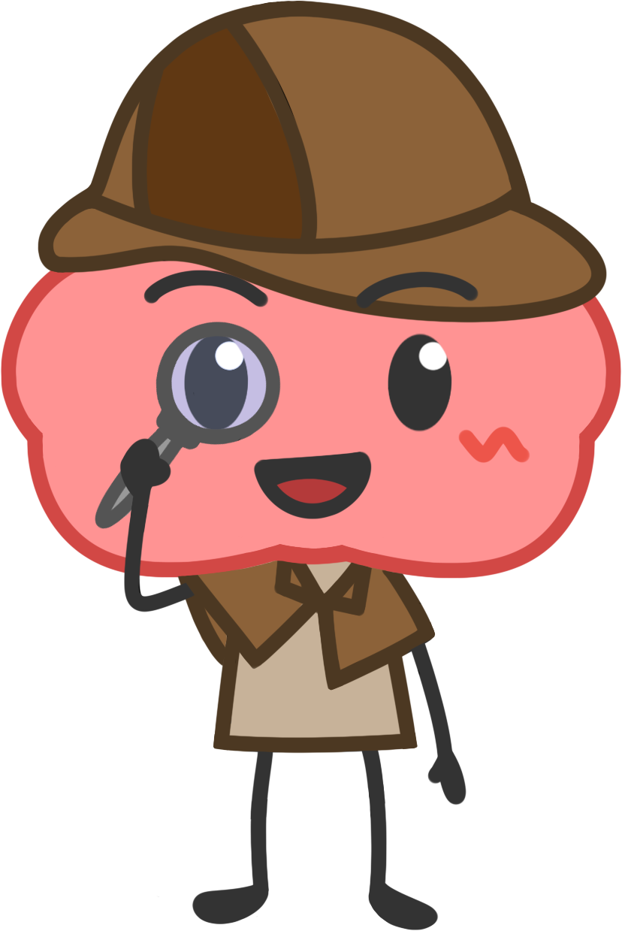
Is the brain an organ?
Notes:
Slide 6 - (2 min):
All cloud slides are key questions that relate to the key theme for today’s lesson: What is the brain?
This is a yes or no question. Have them raise their hand if they think the brain is an organ.
Please refer to “The Volunteer General Guide” for how to make these types of question interactive for your classroom setting.
For someone who says yes, ask them why they think so -> If they don’t know what an organ is then explain it to them (part of the body that does a specific thing).
Do this as you move to the next slide.

Slide 7
Is the brain an organ?
What are
organs?
Notes:
Slide 7:
All cloud slides are key questions that relate to the key theme for today’s lesson: What is the brain?
This question is a continuation from the first one: See if they know what organs are and if so, ask them to give examples. -> Can continue this by asking them what organs do in the body.
Please refer to “The Volunteer General Guide” for how to make these types of question interactive for your classroom setting.

Slide 8
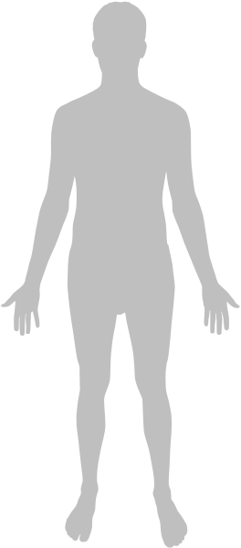
The brain is an organ in our body
Brain
Examine the human body model
Do you recognize any other organs?
Write a list!
Notes:
Slide 8 - (8 min):
Start from the bigger picture: The human body as a whole.
An organ is a part of our body that has a special function. -> The brain is an organ.
Let’s take a moment now to discover the other organs in the human body with an activity.
Here, for the human body task during the pandemic, we can screen share and share our screen with the children’s teacher.
We’ll use a hyperlink for the volunteers to make access to the body atlas: https://www.zygotebody.com OR https://www.healthline.com/health/human-body-maps
Students can come up with a list of five organs they are able to recognize. Have the students write the list on a piece of scrap paper to help them keep on task.
Please refer to “The Volunteer General Guide” for tips on virtual activities.
Image adapted from: freepik.com

Slide 9
Do organs work
alone?
Notes:
Slide 9 - (2 min):
All cloud slides are key questions that relate to the key theme for today’s lesson: What is the brain?
This is a yes or no question. Have them raise their hand if they think organs work alone/don’t interact with other stuff in the body.
Please refer to “The Volunteer General Guide” for how to make these types of question interactive for your classroom setting.
For someone who says no, ask them why they think so -> Relate this to the idea of systems that will be introduced on slide 11.

Slide 10
Do organs work
alone?
Does the brain
work alone?
Notes:
Slide 10:
All cloud slides are key questions that relate to the key theme for today’s lesson: What is the brain?
This question is a continuation from the first one: This is a yes or no question. Have them raise their hand if they think the brain works alone.
Please refer to “The Volunteer General Guide” for how to make these types of question interactive for your classroom setting.
For someone who says no, ask them if they know what the brain works with. Connect the brain working with other stuff with the idea that the brain is part of a system (nervous system).

Slide 11
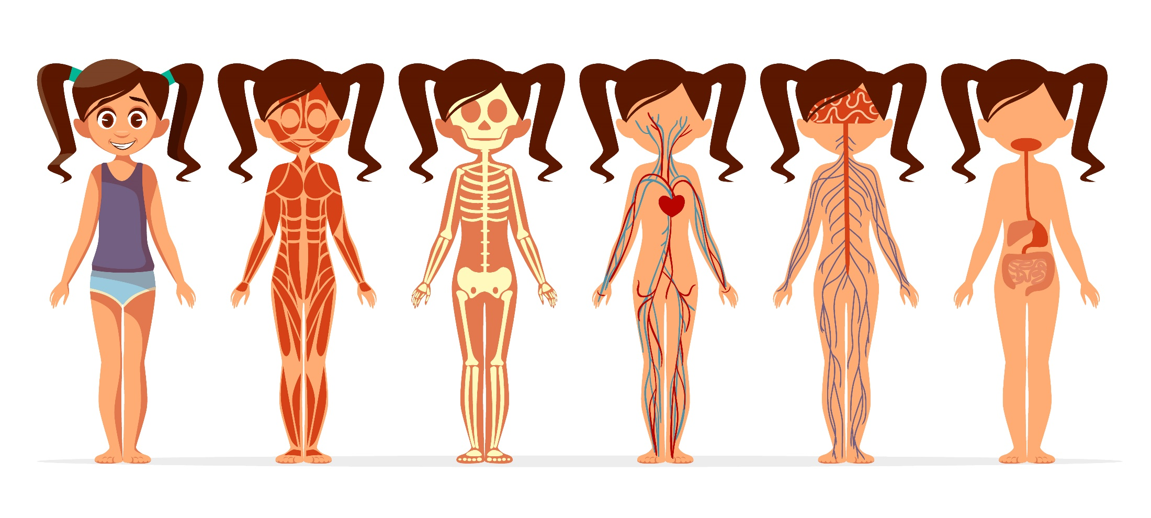
Human body systems
Muscular system
Skeletal system
Cardio-vascular system
Nervous system
Digestive system
Notes:
Slide 11 - (2 min):
Note the nervous system and explain to the students that the nervous system is just one of many types of systems in our body. Each of these systems is very important for a different function of the body. Pick any of two systems to discuss with the students
What does the muscular system do?
What does the digestive system do?
The nervous system is actually connected to all the other systems to help control their functioning. For example, a part of the brain subconsciously regulates the muscles that make our heart beat!
Image: freepik.com

Slide 12
The Nervous System
Notes:
Slide 12 - (3 min):
Slides 12-14 are here to see if the students know the 3 basic parts of the nervous system: Brain, spinal cord, and nerves.
We now know that the brain is the main processing center (like a computer). Continue by asking the students, how to you think the brain communicates with rest of the body? Brainstorm ideas. Ask them: what is our brain connected to? (you can point to your back if they are having trouble!). They might say “vertebral column” clarify that this protects something very important in the center of it…our spinal cord!! Our nervous system is like a highway for cars. Some information leaves the brain to travel down our spinal cord (in vertebral column) and reaches our fingertips or toes by passing through our nerves. Other information starts out at our fingertips and toes, travels through our nerves to our spinal cord and back to the brain. The brain, spinal cord and nerves make up the nervous system.
HERE, ask the students by pointing to each part of the nervous system using your mouse as though you had a laser pointer. (Think that as long as the students can see you, this activity can still be done.).
Image: freepik.com

Slide 13
The Nervous System
Notes:
Slide 13:
Get the students to try to name the 3 basic parts of the nervous system: Brain, spinal cord, and nerves.

Slide 14
Brain
Spinal Cord
The Nervous System
Nerves
Notes:
Slide 14:
Please provide the students with the names of each part of the nervous system and slowly point to them each using your mouse like you would if you were directly pointing to each region with a laser pointer.

Slide 15
What does our brain look like?
Notes:
Slide 15 - (1 min):
All cloud slides are key questions that relate to the key theme for today’s lesson: What is the brain?
This question is meant to transition into our next major question: Why do brains have folds?
Ask the teacher to choose 3 students who raise their hands to come to the microphone and say what they think. Always validate the students’ ideas
You may write their ideas all down on the zoom board (or on your slide).
Please refer to “The Volunteer General Guide” for how to make these types of question interactive for your classroom setting.

Slide 16
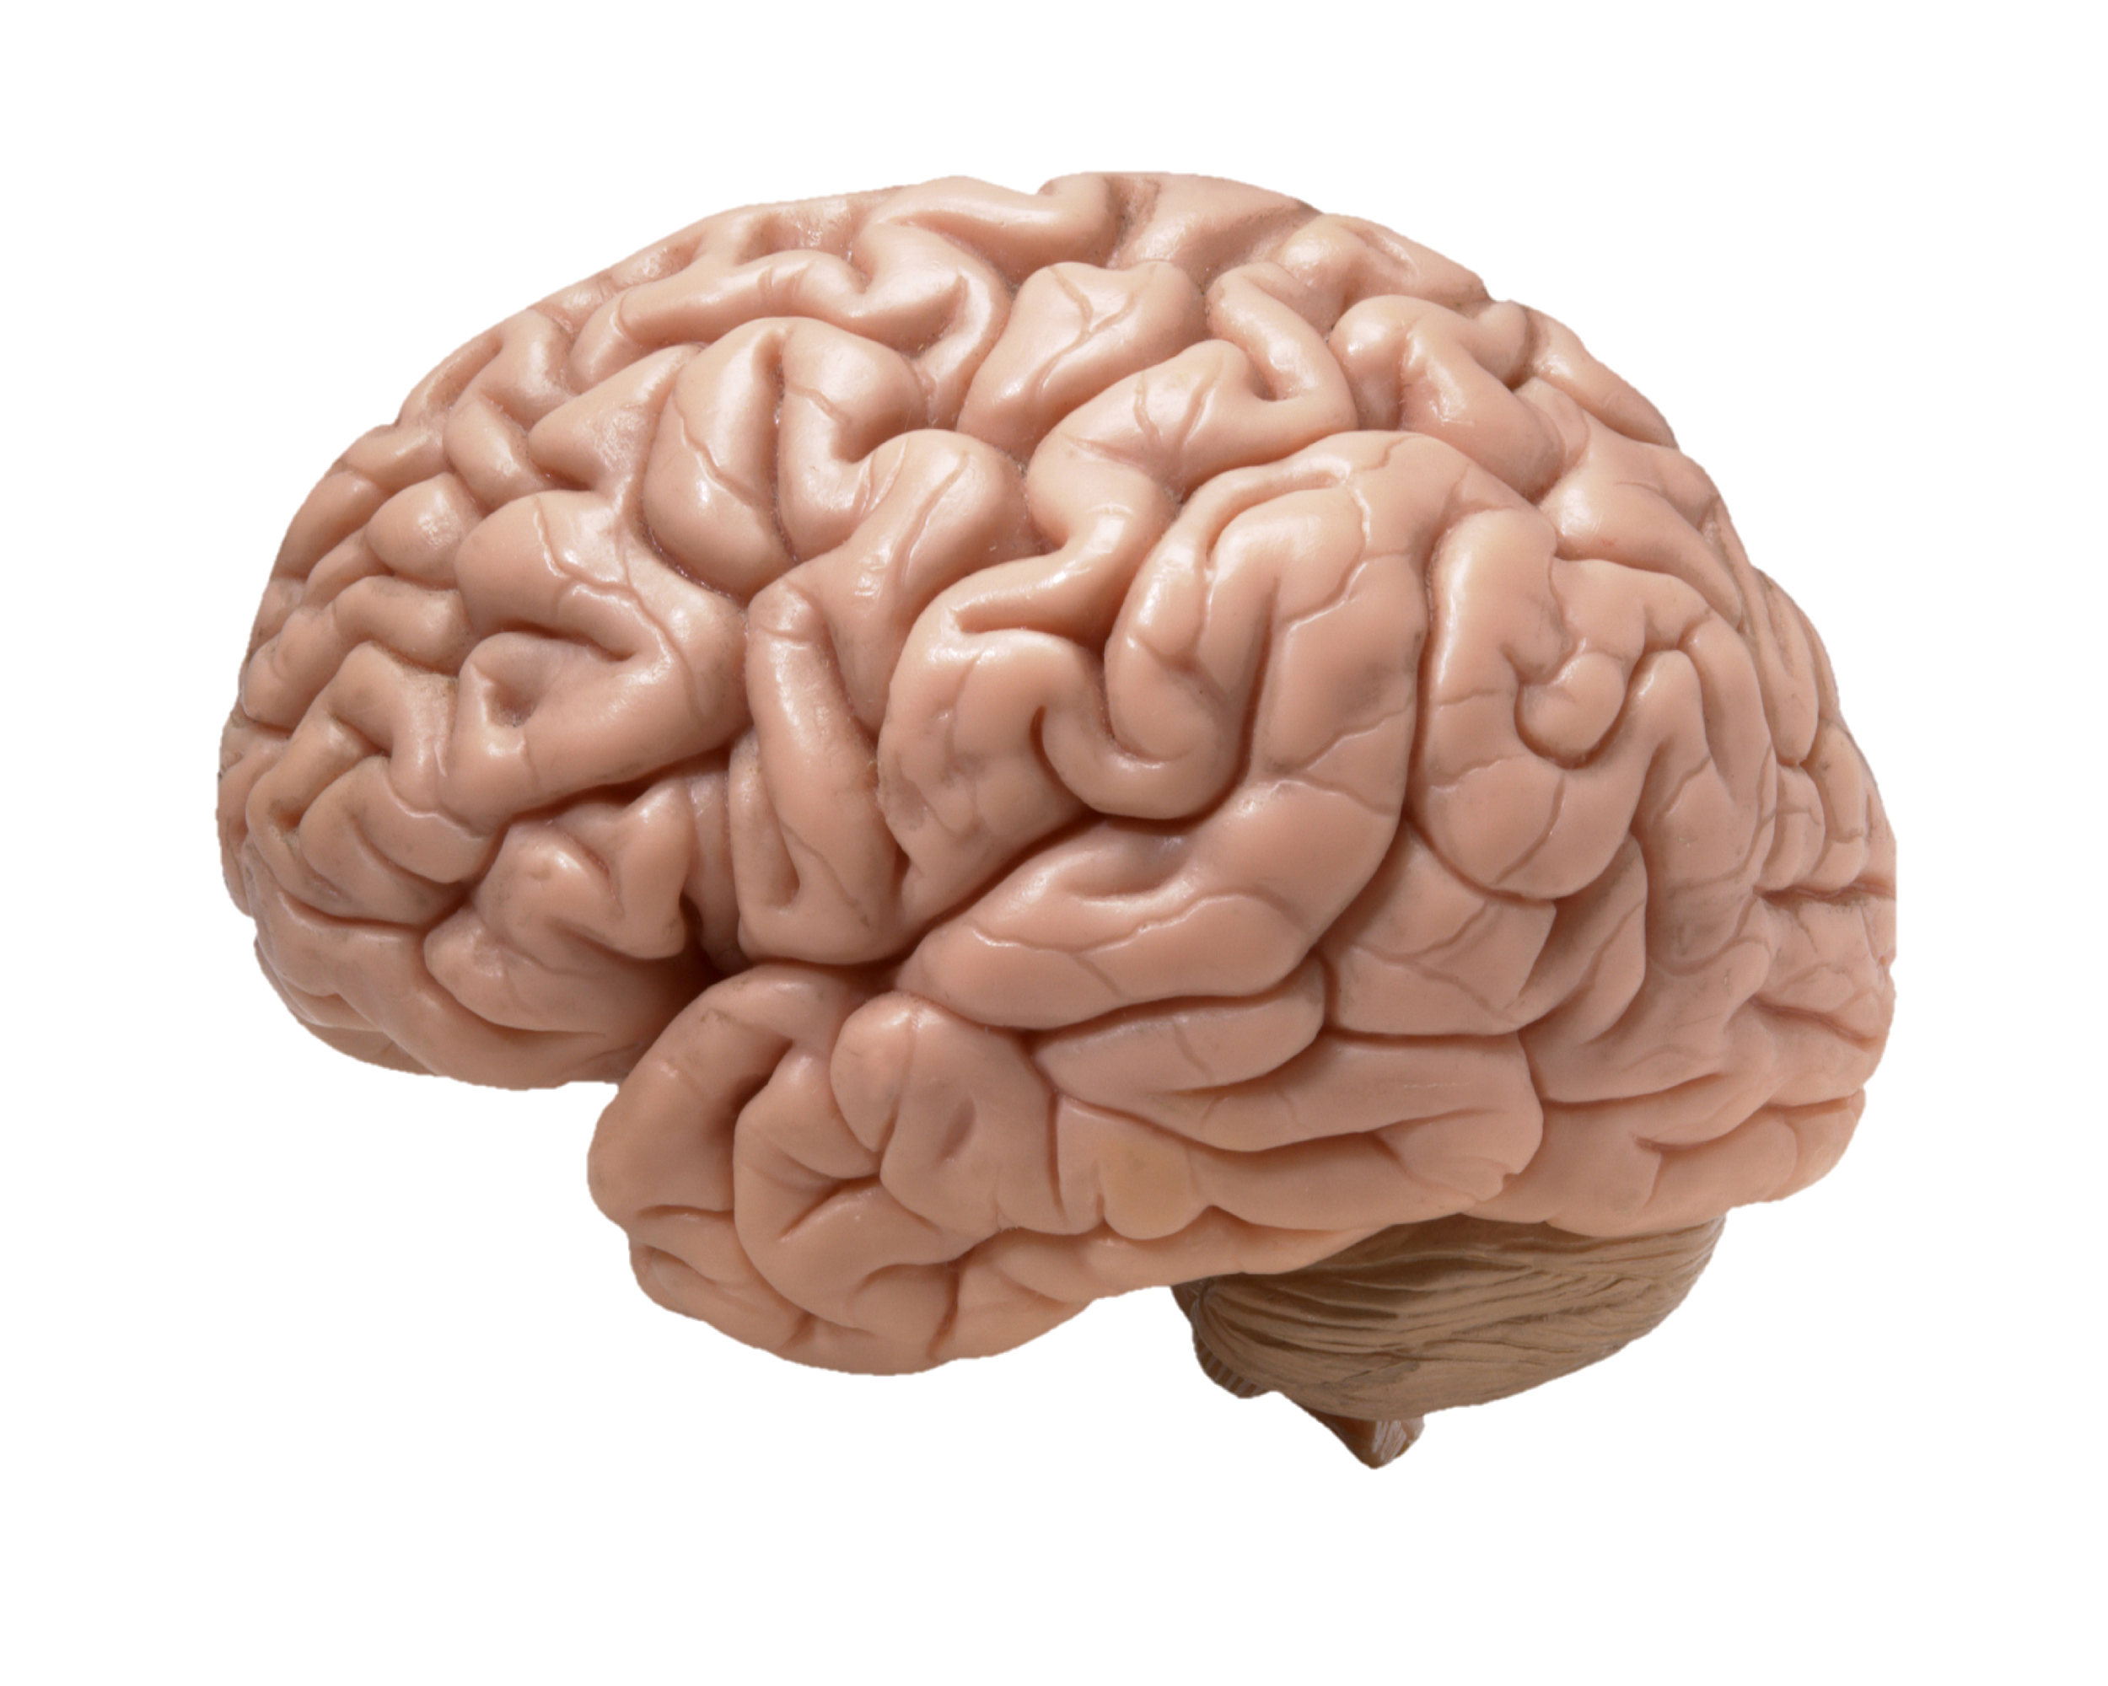
The Human Brain
What do you notice about how the brain looks?
Notes:
Slide 16 - (1 min):
This slide is meant to guide students to idea that brains have many folds.
Ask the students what they see -> Guide them to the idea that the brain is wrinkly and has many folds.
If time allows it, encourage the students to talk with their classmates to brainstorm together for 1-3 minutes.
Please refer to “The Volunteer General Guide” for how to make these types of question interactive for your classroom setting.

Slide 17
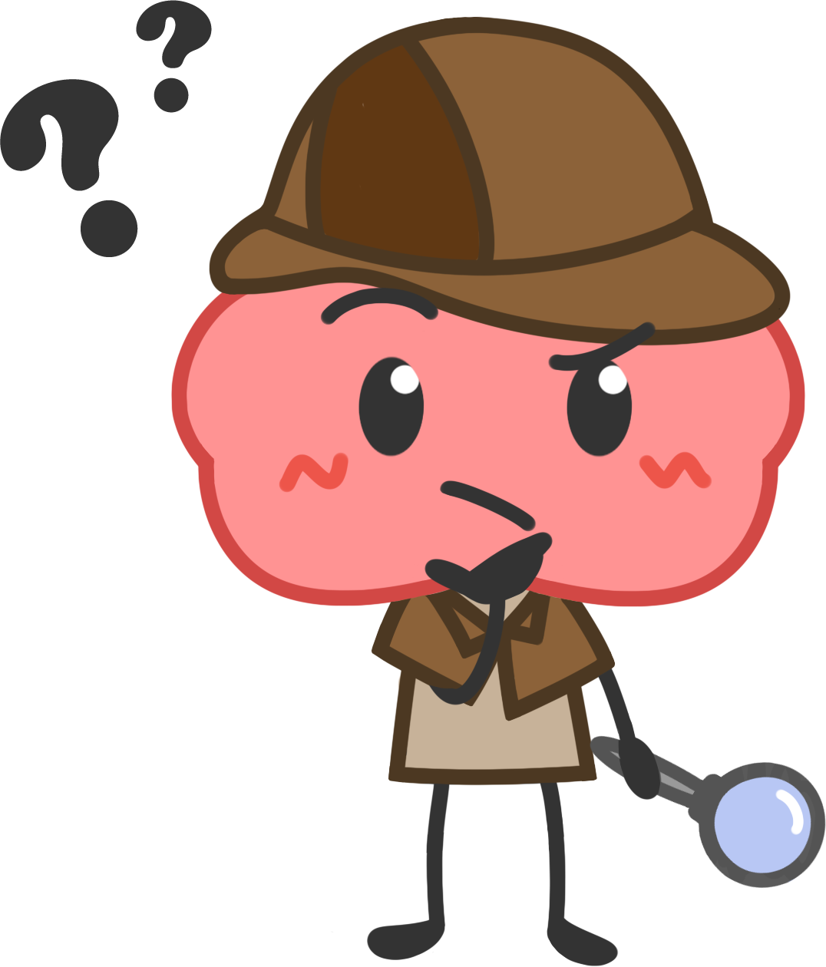
Why does a brain have folds?
Notes:
Slide 17 - (~2 min):
In your brainstorming on the previous slide, the students probably noticed that most of the brains look “wrinkly.” But why does the brain have these folds?
Ask them to take out a scrap piece of paper. Tell the students that the paper is their brain and their pocket is their head. Ask them how they would fit their brain in their head? Tell them they have 1 min to do this and the only rule is that they cannot tear the paper into small pieces!
Answer: Good strategies are to fold it, or crumple it. Why is that? Crumple a piece of paper into a ball and show it to the students. Does it look wrinkly like our brain? Our brains are folded so that more brain fits into our skulls (just like folding the paper helped us fit something that was bigger in a smaller space). Show the students two pieces of paper, one that is full size, and one that you have cut to the size of your pocket. Which could they write more on? Similar to this, if you had two brains that were the same size, one that had wrinkles/folds, and one that did not, the folded one would be able to store more information.
Note that even during the pandemic, these same steps can apply! — be sure to show the students the rationale of the brain’s folders using your own pieces of paper - even if a screen is not available for you to see them, talk your students through it!

Slide 18
Why does a brain have folds?
The paper in the pocket challenge!
Notes:
Slide 18 - (~2 min):
In your brainstorming on the previous slide, the students probably noticed that most of the brains look “wrinkly.” But why does the brain have these folds?
Ask them to take out a scrap piece of paper. Tell the students that the paper is their brain and their pocket is their head. Ask them how they would fit their brain in their head? Tell them they have 1 min to do this and the only rule is that they cannot tear the paper into small pieces!
Answer: Good strategies are to fold it, or crumple it. Why is that? Crumple a piece of paper into a ball and show it to the students. Does it look wrinkly like our brain? Our brains are folded so that more brain fits into our skulls (just like folding the paper helped us fit something that was bigger in a smaller space). Show the students two pieces of paper, one that is full size, and one that you have cut to the size of your pocket. Which could they write more on? Similar to this, if you had two brains that were the same size, one that had wrinkles/folds, and one that did not, the folded one would be able to store more information.
Note that even during the pandemic, these same steps apply — be sure to show the students the rationale of the brain’s folders using your own pieces of paper - even if a screen is not available for you to see them, talk your students through it!
On this slide, ask the students to fit the paper into their pocket and show them the difference between your two papers (one crumpled, one not) on your screen.

Slide 19
Why does a brain have folds?
Notes:
Slide 19 - (optional, ~ 2 min):
This is a Bill Nye video discussing the folds of the brain, which reinforces the previous activity using the analogy of a newspaper.
Show this video only if you have time. Some classes are shorter than others, use your discretion.
Note: This video is in English.
Note #2: Save the video file separately and play it on a media player, it likely will not work in the powerpoint presentation.
LINK FOR VIDEO ON YOUTUBE: https://www.youtube.com/watch?v=Camj8085Te0

Slide 20
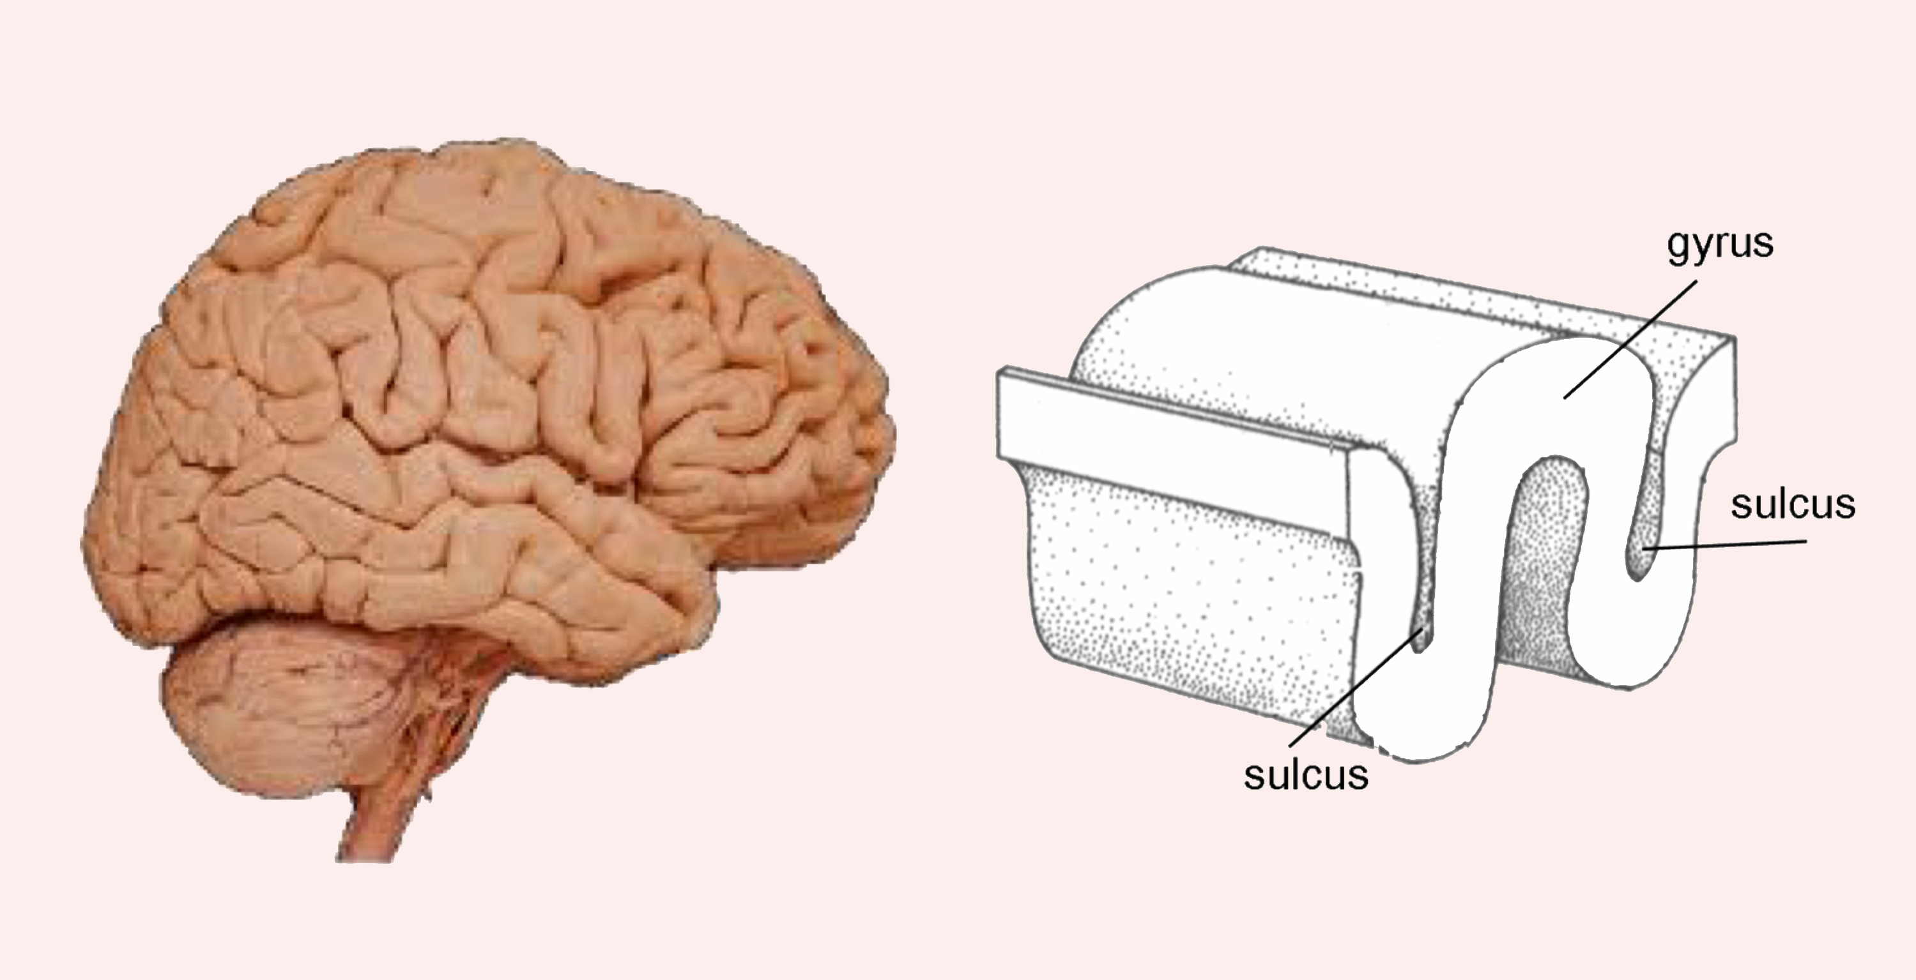
Brain folds have special names
Gyrus
Gyrus
Sulcus
Sulcus
Sulcus
Notes:
Slide 20 - (~2 min):
Part of the science curriculum in grade 4 requires students to learn new scientific terms and use them in the proper context. Today we will introduce the terms gyrus and sulcus, which are used to describe the folds in the brain. A gyrus is what we call the top of each fold (ie. the bumps), while a sulcus is what we call the bottom of each fold (ie. the cracks/grooves). Have the students repeat these new words out loud.
Summarize what they have just learned: The brain looks folded. These folds are called gyri and sulci. Why is the brain folded: so that more brain can fit into our skulls! Bigger animals need bigger brains. During evolution our brains grew faster than our heads. In order to fit them in our heads, they became wrinkled. On average, the more wrinkled the brain, the more intelligent/evolved the animal. (These hints will help them for the following activity).
A fun activity (if time allows) is to hold your hands above you head forming a peak and say “GYRUS!”, and then move your hands down to form a crevice and say “SULCUS!”, taking the time to pronounce both so that the students grasp these new words. They may giggle or look at you with wide eyes, both of which are excellent responses!

Slide 21
Do all animals have a brain?
Notes:
Slide 21 - (2 min):
All cloud slides are key questions that relate to the key theme for today’s lesson: What is the brain?
This question is meant to guide the students to thinking about what other animals’ brains look like.
This is a yes or no question. Have them raise their hand if they think all animals have a brain.
Please refer to “The Volunteer General Guide” for how to make these types of question interactive for your classroom setting.
For someone who says yes, ask them why they think so.

Slide 22
Do all animals have a brain?
Do their brains
look the same?
Notes:
Slide 22:
All cloud slides are key questions that relate to the key theme for today’s lesson: What is the brain?
This question is meant to guide the students to thinking about what other animals’ brains look like.
This question is a continuation from the first one: This is a yes or no question. Have them raise their hand if they think all animals’ brains look the same.
Please refer to “The Volunteer General Guide” for how to make these types of question interactive for your classroom setting.
For someone who says no, ask them how they think they are different.

Slide 23
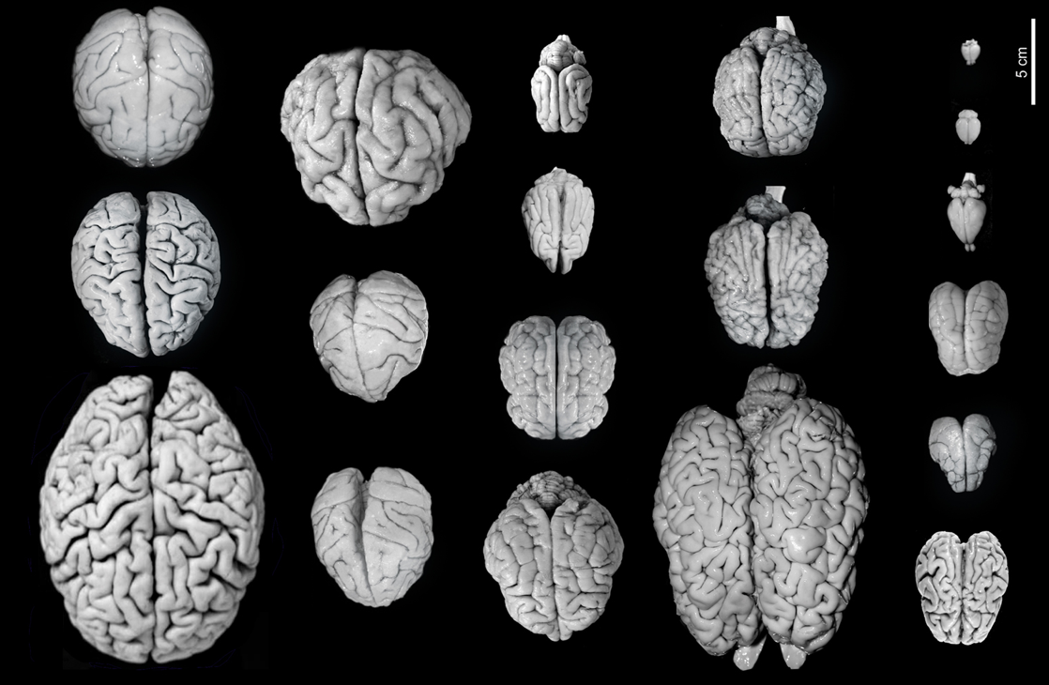
What are some similarities and differences?
Notes:
Slide 23 - (~3 min):
In this picture you see different brains from many different animals. Have the students discuss: What are the similarities? What are the differences?
Please refer to “The Volunteer General Guide” for how to make these types of question interactive for your classroom setting.

Slide 24
Let’s guess which brain belongs to which animal
Brains across species
Notes:
Slide 24 - (~10 min):
MATERIALS FOR ACTIVITY (only if the teacher agrees to print): matching cards. After the activity, when taking up the answers on slide 12, you will need the “answer handout.”
You can have the students do this activity in pairs or alone. Each person/pair gets a set of laminated matching cards. The goal of the activity is to match each brain to the correct animal. Let them know that all the brains have been made the same size so that it wouldn’t be too easy for them!! Give them about 5 min to complete this task. Remind them what we just talked about. Brains became wrinklier as species evolved and that larger animals often have wrinklier brains. If they need another hint, they can look at the direction of the brainstem, which you can tell them is connected to the spinal cord.
Before skipping to the next slide and showing them the answers, have the students share their answers with you. Alternatively, you can point to one of the brains and have the students vote for which animal it is based on their answers.
There are two other “virtual” options for this activity a and b; both are slight adjustments on the original activity. Please select ONE based on feasibility for the class size.
A) MULTIPLE CHOICE GAME (good for larger classes)! Show 3 animal brains and ask the students to work in a group to decide which animals they think they are from (using a crop from slide 32) — give them around 5-7 minutes for the full activity. Ask each group what they think for each animal brain. Were they right? If they were, congratulate them. If they weren’t, tell them that this is ok too!
Brains became wrinklier as species evolved and that larger animals often have wrinklier brains. If they need another hint, they can look at the direction of the brainstem, which you can tell them is connected to the spinal cord.
Tell them that the brain can look funny, and that they’ve just conducted a scientific experiment!
B) CONNECT THE PICTURE TO THE NAME (good for smaller-medium size classes): Before the beginning of the lesson, ask the teacher to print each student a paper that allows them to connect animal brains to their respective animal. Encourage the students to complete the activity in groups of 3 or 4, for 5-7 minutes. If the students need help, encourage them to come up to the microphone to ask you. Provide the students with hints by reminding them what we just talked about! Brains became wrinklier as species evolved and that larger animals often have wrinklier brains. If they need another hint, they can look at the direction of the brainstem, which you can tell them is connected to the spinal cord. Then, continue onto slide 31 for answers!
LINK FOR ANIMAL/BRAIN MATCHING GAME: https://drive.google.com/file/d/156650a3mXZSsF0TYkcmzzg5hvTqjiT4r/view?usp=sharing

Slide 25
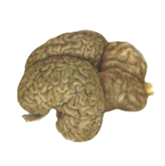
Brains across species
A) MONKEY C) CAT
B) DOLPHIN D) BUNNY
Notes:
Slide 25:
Additional information for presenters:
This information is from the following website: http://thebrain.mcgill.ca/flash/i/i_05/i_05_cr/i_05_cr_her/i_05_cr_her.html
Ever since the first mammals appeared more than 200 million years ago, the cerebral cortex has assumed greater and greater importance compared with the brain's other, older structures. Because these structures had proven their effectiveness for meeting certain fundamental needs, there was no reason for them to disappear. Instead, evolution favoured a process of building expansions and additions, rather than rebuilding everything from the bottom up. This expansion of the surface of the neocortex (also known as the isocortex) is more apparent in predatory mammals than in herbivorous ones. Catching prey may be difficult, but a successful hunt provides a far more nutritious meal than any plant. To hunt successfully requires a highly evolved sensorimotor system. Mammals with a large neocortex thus have an advantage, because that is where the sensory and motor regions are located. Scientists have also observed that the size of the neocortex has increased tremendously in primates, from the smallest monkeys, such as lemurs, on to the great apes and human beings. Many scientists believe that this growth in the primates’ neocortex reflects the growing complexity of their social lives. Indeed, the ability to predict the behaviour of other individuals within a group seems to have conferred a large evolutionary advantage. Thus evolution would have favoured the growth of certain parts of the cortex that are responsible for social skills such as language, because they improved this ability.
Another point on which everyone agrees is that the increase in the folds of the cortex has been a major factor in the evolution of the brain. These folds, by enabling a larger cortical surface area to fit inside the cranial vault, allow for a better organization of complex behaviors.

Slide 26
Brains across species
A) MONKEY C) CAT
B) DOLPHIN D) BUNNY
Notes:
Slide 26:
Additional information for presenters:
This information is from the following website: http://thebrain.mcgill.ca/flash/i/i_05/i_05_cr/i_05_cr_her/i_05_cr_her.html
Ever since the first mammals appeared more than 200 million years ago, the cerebral cortex has assumed greater and greater importance compared with the brain's other, older structures. Because these structures had proven their effectiveness for meeting certain fundamental needs, there was no reason for them to disappear. Instead, evolution favoured a process of building expansions and additions, rather than rebuilding everything from the bottom up. This expansion of the surface of the neocortex (also known as the isocortex) is more apparent in predatory mammals than in herbivorous ones. Catching prey may be difficult, but a successful hunt provides a far more nutritious meal than any plant. To hunt successfully requires a highly evolved sensorimotor system. Mammals with a large neocortex thus have an advantage, because that is where the sensory and motor regions are located. Scientists have also observed that the size of the neocortex has increased tremendously in primates, from the smallest monkeys, such as lemurs, on to the great apes and human beings. Many scientists believe that this growth in the primates’ neocortex reflects the growing complexity of their social lives. Indeed, the ability to predict the behaviour of other individuals within a group seems to have conferred a large evolutionary advantage. Thus evolution would have favoured the growth of certain parts of the cortex that are responsible for social skills such as language, because they improved this ability.
Another point on which everyone agrees is that the increase in the folds of the cortex has been a major factor in the evolution of the brain. These folds, by enabling a larger cortical surface area to fit inside the cranial vault, allow for a better organization of complex behaviors.

Slide 27
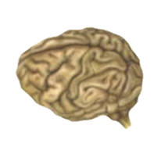
Brains across species
A) MONKEY C) SHEEP
B) HUMAN D) GIRAFFE
Notes:
Slide 27:
Additional information for presenters:
This information is from the following website: http://thebrain.mcgill.ca/flash/i/i_05/i_05_cr/i_05_cr_her/i_05_cr_her.html
Ever since the first mammals appeared more than 200 million years ago, the cerebral cortex has assumed greater and greater importance compared with the brain's other, older structures. Because these structures had proven their effectiveness for meeting certain fundamental needs, there was no reason for them to disappear. Instead, evolution favoured a process of building expansions and additions, rather than rebuilding everything from the bottom up. This expansion of the surface of the neocortex (also known as the isocortex) is more apparent in predatory mammals than in herbivorous ones. Catching prey may be difficult, but a successful hunt provides a far more nutritious meal than any plant. To hunt successfully requires a highly evolved sensorimotor system. Mammals with a large neocortex thus have an advantage, because that is where the sensory and motor regions are located. Scientists have also observed that the size of the neocortex has increased tremendously in primates, from the smallest monkeys, such as lemurs, on to the great apes and human beings. Many scientists believe that this growth in the primates’ neocortex reflects the growing complexity of their social lives. Indeed, the ability to predict the behaviour of other individuals within a group seems to have conferred a large evolutionary advantage. Thus evolution would have favoured the growth of certain parts of the cortex that are responsible for social skills such as language, because they improved this ability.
Another point on which everyone agrees is that the increase in the folds of the cortex has been a major factor in the evolution of the brain. These folds, by enabling a larger cortical surface area to fit inside the cranial vault, allow for a better organization of complex behaviors.

Slide 28
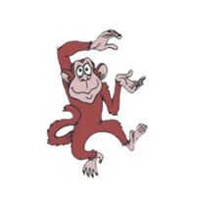
Brains across species
A) MONKEY C) SHEEP
B) HUMAN D) GIRAFFE
Notes:
Slide 28:
Additional information for presenters:
This information is from the following website: http://thebrain.mcgill.ca/flash/i/i_05/i_05_cr/i_05_cr_her/i_05_cr_her.html
Ever since the first mammals appeared more than 200 million years ago, the cerebral cortex has assumed greater and greater importance compared with the brain's other, older structures. Because these structures had proven their effectiveness for meeting certain fundamental needs, there was no reason for them to disappear. Instead, evolution favoured a process of building expansions and additions, rather than rebuilding everything from the bottom up. This expansion of the surface of the neocortex (also known as the isocortex) is more apparent in predatory mammals than in herbivorous ones. Catching prey may be difficult, but a successful hunt provides a far more nutritious meal than any plant. To hunt successfully requires a highly evolved sensorimotor system. Mammals with a large neocortex thus have an advantage, because that is where the sensory and motor regions are located. Scientists have also observed that the size of the neocortex has increased tremendously in primates, from the smallest monkeys, such as lemurs, on to the great apes and human beings. Many scientists believe that this growth in the primates’ neocortex reflects the growing complexity of their social lives. Indeed, the ability to predict the behaviour of other individuals within a group seems to have conferred a large evolutionary advantage. Thus evolution would have favoured the growth of certain parts of the cortex that are responsible for social skills such as language, because they improved this ability.
Another point on which everyone agrees is that the increase in the folds of the cortex has been a major factor in the evolution of the brain. These folds, by enabling a larger cortical surface area to fit inside the cranial vault, allow for a better organization of complex behaviors.

Slide 29
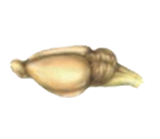
Brains across species
A) MONKEY C) CAT
B) HUMAN D) RAT
Notes:
Slide 29:
Additional information for presenters:
This information is from the following website: http://thebrain.mcgill.ca/flash/i/i_05/i_05_cr/i_05_cr_her/i_05_cr_her.html
Ever since the first mammals appeared more than 200 million years ago, the cerebral cortex has assumed greater and greater importance compared with the brain's other, older structures. Because these structures had proven their effectiveness for meeting certain fundamental needs, there was no reason for them to disappear. Instead, evolution favoured a process of building expansions and additions, rather than rebuilding everything from the bottom up. This expansion of the surface of the neocortex (also known as the isocortex) is more apparent in predatory mammals than in herbivorous ones. Catching prey may be difficult, but a successful hunt provides a far more nutritious meal than any plant. To hunt successfully requires a highly evolved sensorimotor system. Mammals with a large neocortex thus have an advantage, because that is where the sensory and motor regions are located. Scientists have also observed that the size of the neocortex has increased tremendously in primates, from the smallest monkeys, such as lemurs, on to the great apes and human beings. Many scientists believe that this growth in the primates’ neocortex reflects the growing complexity of their social lives. Indeed, the ability to predict the behaviour of other individuals within a group seems to have conferred a large evolutionary advantage. Thus evolution would have favoured the growth of certain parts of the cortex that are responsible for social skills such as language, because they improved this ability.
Another point on which everyone agrees is that the increase in the folds of the cortex has been a major factor in the evolution of the brain. These folds, by enabling a larger cortical surface area to fit inside the cranial vault, allow for a better organization of complex behaviors.

Slide 30
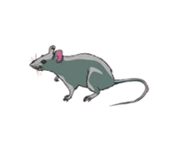
Brains across species
A) MONKEY C) CAT
B) HUMAN D) RAT
Notes:
Slide 30:
Additional information for presenters:
This information is from the following website: http://thebrain.mcgill.ca/flash/i/i_05/i_05_cr/i_05_cr_her/i_05_cr_her.html
Ever since the first mammals appeared more than 200 million years ago, the cerebral cortex has assumed greater and greater importance compared with the brain's other, older structures. Because these structures had proven their effectiveness for meeting certain fundamental needs, there was no reason for them to disappear. Instead, evolution favoured a process of building expansions and additions, rather than rebuilding everything from the bottom up. This expansion of the surface of the neocortex (also known as the isocortex) is more apparent in predatory mammals than in herbivorous ones. Catching prey may be difficult, but a successful hunt provides a far more nutritious meal than any plant. To hunt successfully requires a highly evolved sensorimotor system. Mammals with a large neocortex thus have an advantage, because that is where the sensory and motor regions are located. Scientists have also observed that the size of the neocortex has increased tremendously in primates, from the smallest monkeys, such as lemurs, on to the great apes and human beings. Many scientists believe that this growth in the primates’ neocortex reflects the growing complexity of their social lives. Indeed, the ability to predict the behaviour of other individuals within a group seems to have conferred a large evolutionary advantage. Thus evolution would have favoured the growth of certain parts of the cortex that are responsible for social skills such as language, because they improved this ability.
Another point on which everyone agrees is that the increase in the folds of the cortex has been a major factor in the evolution of the brain. These folds, by enabling a larger cortical surface area to fit inside the cranial vault, allow for a better organization of complex behaviors.

Slide 31
Brains across species
Bigger and more folds!
Notes:
Slide 31:
Here are the answers to the activity. The teacher can hand out the answer sheet at this point if they printed it. The students will keep it in their folder.
Additional information for presenters:
This information is from the following website: http://thebrain.mcgill.ca/flash/i/i_05/i_05_cr/i_05_cr_her/i_05_cr_her.html
Ever since the first mammals appeared more than 200 million years ago, the cerebral cortex has assumed greater and greater importance compared with the brain's other, older structures. Because these structures had proven their effectiveness for meeting certain fundamental needs, there was no reason for them to disappear. Instead, evolution favoured a process of building expansions and additions, rather than rebuilding everything from the bottom up. This expansion of the surface of the neocortex (also known as the isocortex) is more apparent in predatory mammals than in herbivorous ones. Catching prey may be difficult, but a successful hunt provides a far more nutritious meal than any plant. To hunt successfully requires a highly evolved sensorimotor system. Mammals with a large neocortex thus have an advantage, because that is where the sensory and motor regions are located. Scientists have also observed that the size of the neocortex has increased tremendously in primates, from the smallest monkeys, such as lemurs, on to the great apes and human beings. Many scientists believe that this growth in the primates’ neocortex reflects the growing complexity of their social lives. Indeed, the ability to predict the behaviour of other individuals within a group seems to have conferred a large evolutionary advantage. Thus evolution would have favoured the growth of certain parts of the cortex that are responsible for social skills such as language, because they improved this ability.
Another point on which everyone agrees is that the increase in the folds of the cortex has been a major factor in the evolution of the brain. These folds, by enabling a larger cortical surface area to fit inside the cranial vault, allow for a better organization of complex behaviors.

Slide 32
Why do humans have a big and folded brain?
Notes:
Slide 32 - (3 min):
All cloud slides are key questions that relate to the key theme for today’s lesson: What is the brain?
This question is meant to push the idea that human brains allow us to do many different things that other animals cannot. Ex. Drive cars, math, play musical instruments, use computers, etc.
Ask the students to discuss their ideas with their classmates for anywhere between a minute to three minutes and then ask for a few students (maximum number = 3) to come to the microphone and to tell you what their group members think. Then, provide the answer: human brains allow us to do many things that other animals cannot. Ex. Drive cars, math, play musical instruments, use computers, etc.
Please refer to “The Volunteer General Guide” for how to make these types of question interactive for your classroom setting.

Slide 33
Do you think our brain changes
as we grow
older?
Notes:
Slide 33 - (1 min):
All cloud slides are key questions that relate to the key theme for today’s lesson: What is the brain?
This is a yes or no question. Have them raise their hand if they think our brain changes as we grow older.
Please refer to “The Volunteer General Guide” for how to make these types of question interactive for your classroom setting.
For someone who says yes, ask them why they think it changes + how it changes.

Slide 34
Yes, even before we are born!
5 months
before birth
At birth
5 year-old
Huang et al., 2006, Neuroimage
Notes:
Slide 34 - (1 min):
Answer: Our brains do change as we grow older. Not only are our brains growing bigger, but they also become more “wrinkly” as we get older.
Alternatively, you could show the students this slide and ask them to compare the brains at the different ages. Do they notice the differences in shape and the number gyri/sulci. What do they think this means?
The link is provided at the bottom of the slide if you would like to look up more information before your presentation.

Slide 35
What did we learn today?
Notes:
Slide 35 - (~2 min):
Take time to reflect and ask the students what they learned today. This will give you an idea if they are grasping new concepts, and if you need to go faster/slower or change your teaching strategy next time.
You can now either move on to the summary slide or let the teacher hand out the printed summary sheet (if they agreed to).
Please refer to “The Volunteer General Guide” for more information about how to go of the summary handouts

Slide 36
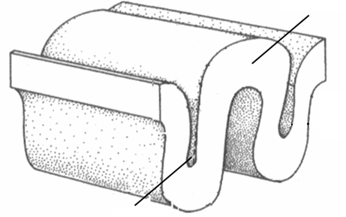
Summary Slide
Scientists are people like you and me who study the natural world; neuroscience is all about the study of the brain and the nervous system. Our brains are organs, that is, a body part that has a unique function.
The nervous system is the ENTIRE combination of the brain, spinal cord, and nerves. The brain has bumps (gyri) and grooves (sulci) and becomes more folded over time. These folds are useful to store A LOT of information. Many animals have brains of different shapes and sizes (including humans).
gyrus
sulcus
Notes:
Slide 36 (~2 min):
**This slide is the summary sheets converted into powerpoint slides**
If you are short on time and your teacher is able to print out the summary sheets for the class you can skip this slide. We do however strongly encourage you to go through this slide with your students
Please refer to “The Volunteer General Guide” for more information about how to ask these types of questions based on your classroom set up.

Slide 37
Questions?
Notes:
Slide 37 - (~3-5 min):
Ask the students if they have any questions. Also introduce the question folder (if the teacher agreed to do this).
Remember to ask the teacher whether they would prefer to provide the BR volunteers with students’ prior questions before each session or at the end of each session.
QUESTION FOLDER: Ask the teacher to keep a folder and write: “Questions for ______ (your name here).” Tell the students that during each session if they have a question you don’t have time to answer, or if they think of a question while you are not there, they can write it on a piece of paper and put it in the folder. You will answer these questions at the start of the next class. This will help encourage students to ask questions, and gives those who are shy an opportunity to think critically and participate. You may chose to pin this folder next to the vocabulary poster, or have the teacher suggest another location.
If the students do not submit many questions, you may want to add questions yourself to the folder so that you can read and answer them next class and encourage the students to use the folder. If students think their peers are using the folder, they’ll be more likely to use it too. Make sure to add questions you are comfortable answering! The questions can be related to the presentations, or general neuroscience questions. For example:
Do our brains get more wrinkled as we learn more?
Why do we lose memories from when we were very young?
What animal has the largest brain?
Are the brain and the spinal cord made up of the same stuff?
What do neuroscientist do at work?
Do we “think” using neurons?
Who are some famous neuroscientists?
How are human brains different from other animals?
What colour is the brain?
What percent of the brain do we use?
Does the brain change as we grow up?
What does the brain feel like? Is it sticky? Is it slimy?

Slide 38
Supplementary
Notes:
Slide 38:
Can show this last slide if you have extra time (not mandatory).

Slide 39
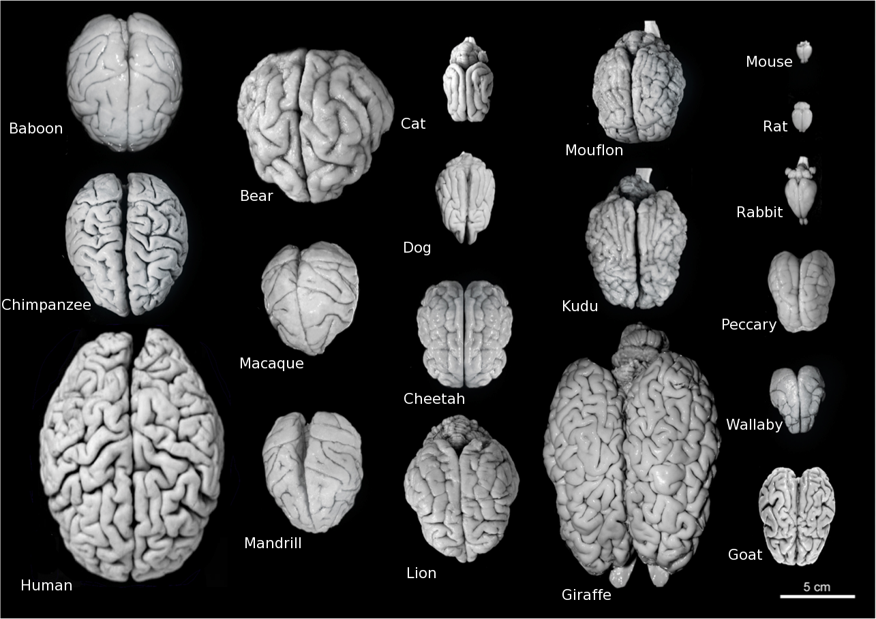
Not all brains are the same size!
Notes:
Slide 39 - (~1 min):
This slide shows the relative sizes of the animal brains from the activity. It also shows again the image from slide 23, this time with the animal names included.
FYI for presenters:
Mandrill – Old World monkey, closely related to baboon
Mouflon – Wild sheep
Kudu – subspecies of antelope
Wallaby – macropod, looks like a small kangaroo
Peccary – medium sized animal with resemblance to a pig

